Slide 1
Dating advice

Slide 2


Looking for a date…
Online….???…

Slide 3
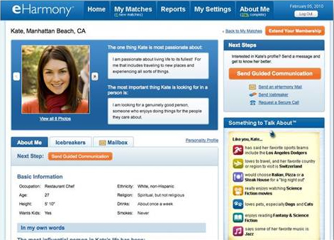
A profile

Slide 4
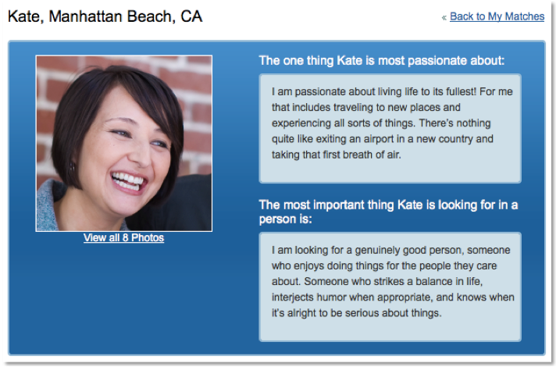

Slide 5
https://www.youtube.com/watch?v=mTTwcCVajAc

Slide 6



Slide 7


Slide 8


Slide 9
Reading : Who pays?

Slide 10


Slide 11
